Slide 1
Multiple Object Tracking Using Particle
Paper : Robust Tracking-by-Detection using a Detector Confidence Particle Filter
Authors: Michael D. Breitenstein, Fabian Reichlin, Bastian Leibe, Esther Koller-Meier, Luc Van Gool
Conference: 2009 IEEE 12th International Conference on Computer Vision (ICCV)

Slide 2
Multiple Object Tracking Problem Definition
Given a image sequence that contains multiple objects, find the state (position, size) of each object across the frames, and link the states of each object into trajectories.
It is a ill-posed and inverse computer vision problem
Notes:
Due to occlusions, for example a person walk behind a wall, there is no unique solution of the object’s state, because the information is lost behind the wall

Slide 3
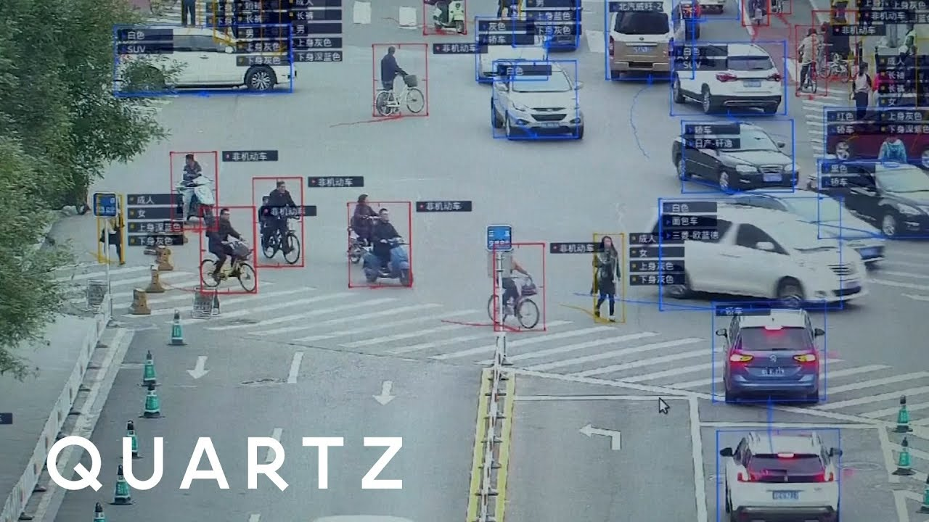
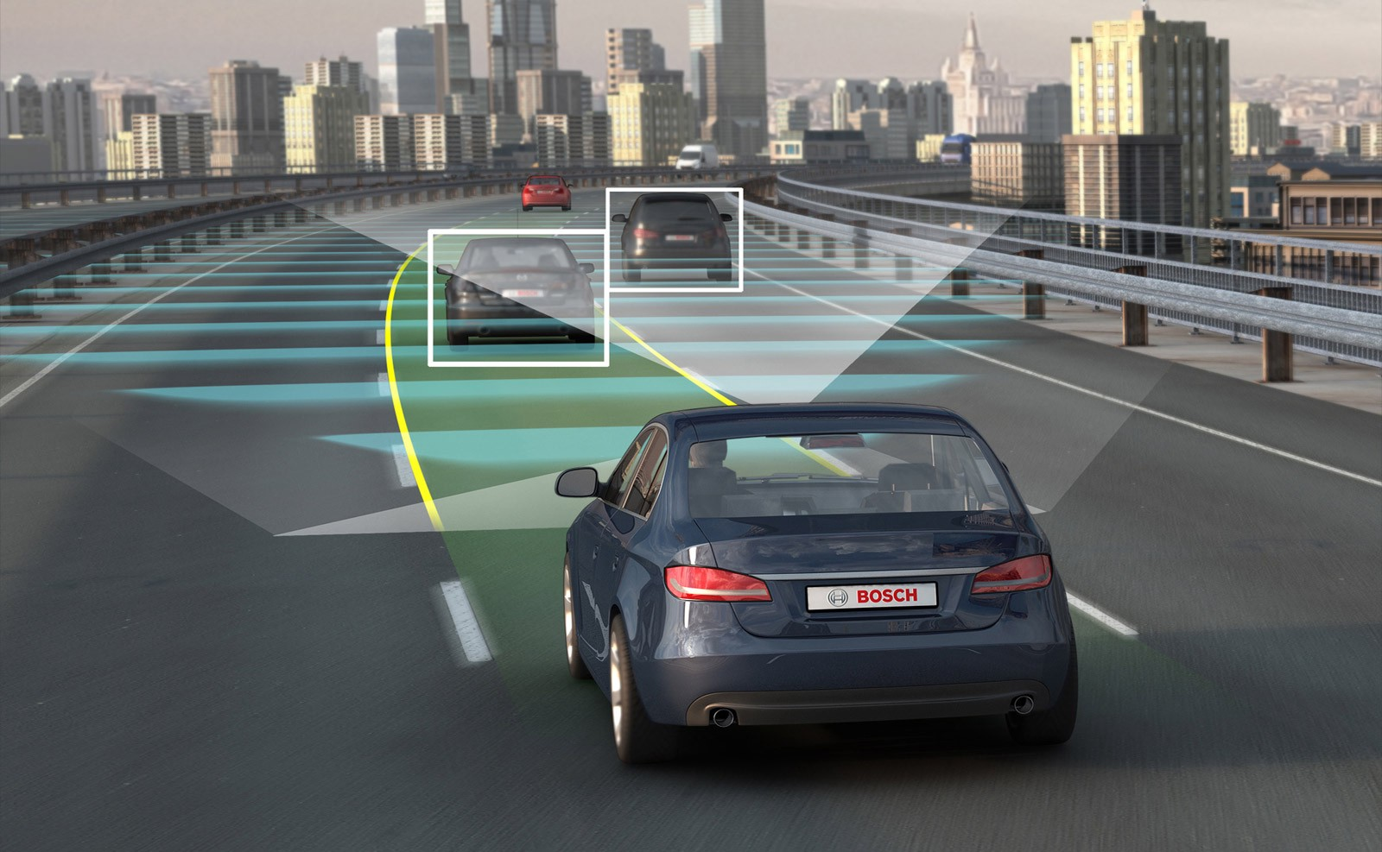
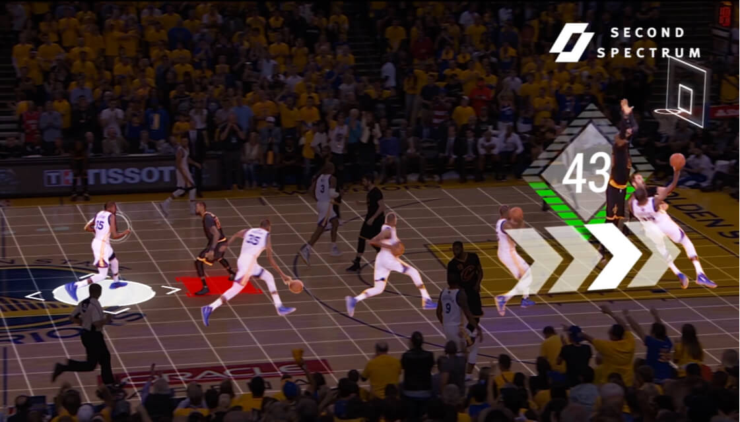
Applications
Sport Analytics
Visual surveillance
Autonomous driving
And more
Images courtesy of Second Spectrum, Quartz and auto.economictimes.com

Slide 4
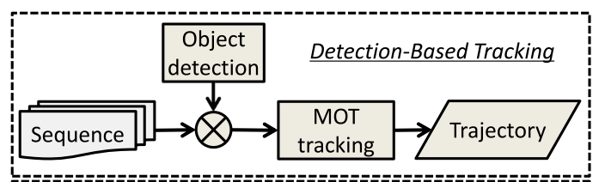
Detection based Multiple object tracking
Formulate the tracking problem as a first order Markov model, where the object tracking only relies on the current and last time step
Image courtesy of Multiple Object Tracking: A Literature Review by Luo et. al.

Slide 5
Other Multiple Object tracking Models
Recurrent Net
Tracking The Untrackable: Learning to Track Multiple Cues with Long-Term Dependencies by Sadeghian et. al. ICCV 2017
Reinforcement Learning
Learning to Track: Online Multi-Object Tracking by Decision Making by Xiang et. al. ICCV 2015
Graphical Method
Multiple people tracking by lifted multicut and person re-identification by Tang et. al. CVPR 2017

Slide 6
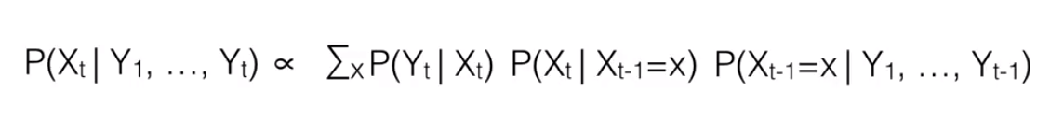
What is a Particle Filter
Goal: to estimate the Posterior distributions of Markov Process, given some noisy observations
Approach:
Use a set of particles to represent the posterior distribution
Propagate particles using the transition model
Given an observation of next state, each particle has a likelihood weight
Resample particles according to the likelihood weights, and we get the new set of particles to represent the posterior for next state
Before observation
Likelihood weight
Transition Model
Previous posterior estimation
Notes:
Probability of end up at certain state given previous state

Slide 7
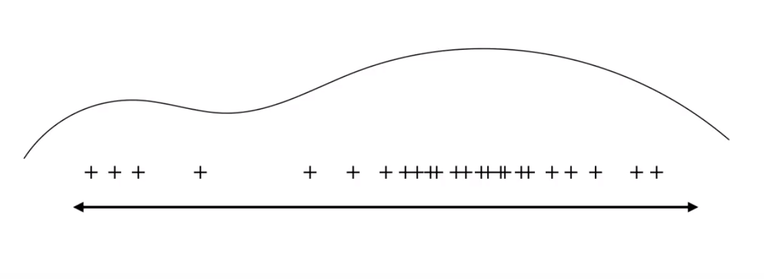
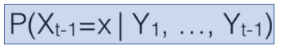
Particle Filtering
Images taken from Bert Huang’s Youtube Lecture https://www.youtube.com/watch?v=lzN18y_z6HQ&t=475s
Notes:
Density of the samples represents the density of the posterior
Estimation from last state

Slide 8
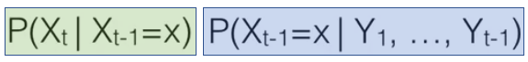
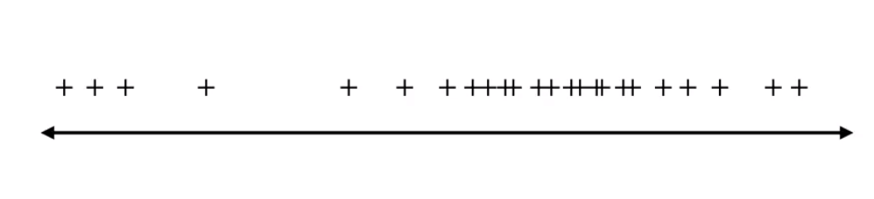
Transition
According to the transition probability model
Image taken from Bert Huang’s Youtube Lecture https://www.youtube.com/watch?v=lzN18y_z6HQ&t=475s

Slide 9
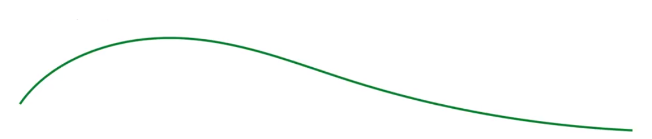
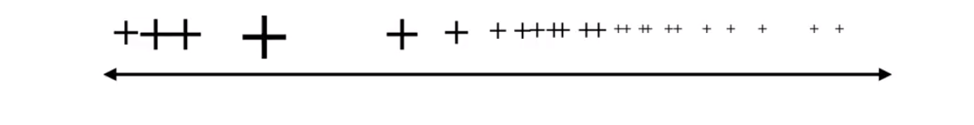
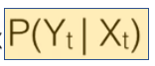
Reweight
According to the new observation
Images taken from Bert Huang’s Youtube Lecture https://www.youtube.com/watch?v=lzN18y_z6HQ&t=475s

Slide 10
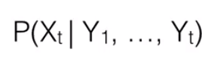
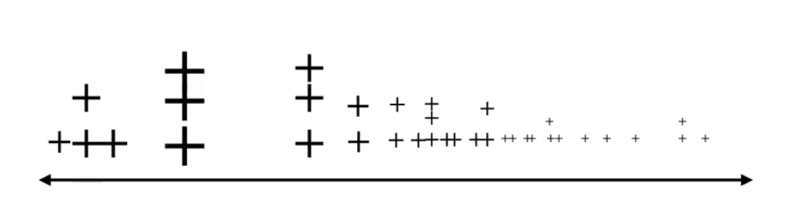
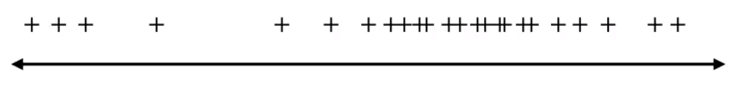
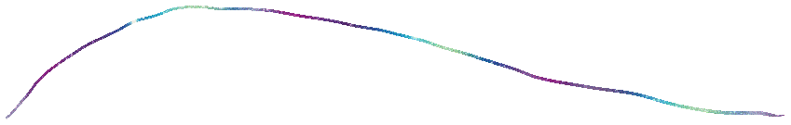
Resample
A new set of particle to represent the next state posterior
Image taken from Bert Huang’s Youtube Lecture https://www.youtube.com/watch?v=lzN18y_z6HQ&t=475s

Slide 11
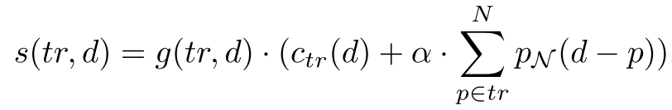
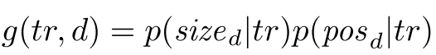
Particle Filter Multiple Object Tracking
A individual particle filter is assigned to each track, where each particles contains the position and x, y direction speed
At each time step, assign detections to each track greedily according to the similarity score
where
Initialize trackers for the qualified unmatched detections
- qualified means not occluding with other detections, and the
position of the box is at the boundaries
Equations are taken from the paper Robust Tracking-by-Detection using a Detector Confidence Particle Filter by Breitenstein et. al.
Notes:
Gating function considers weather the size and position of the detection matches this a track, the stuff in the brackets compares the appearance of the tracker and the detection as well as the individual particles’ location with the detection

Slide 12
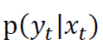
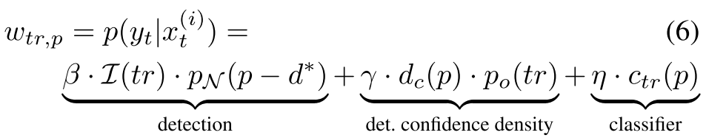
Particle Filter Multiple Object Tracking
For each particle filter (track) the newly assigned detection is the bounding box
Reweight the particles according to the observation likelihood
calculated as follow:
Resample the particles according to the weights to get the new posterior distribution.
Equations are taken from the paper Robust Tracking-by-Detection using a Detector Confidence Particle Filter by Breitenstein et. al.

Slide 13
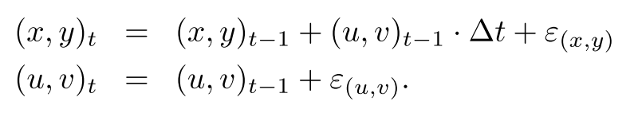
Particle Filter Multiple Object Tracking
Propagate the particles to produce the estimation of the next state according to the motion model. Each particle’s state is a 4 element vector (x, y, u, v).
Where ɛ is zero mean gaussian noise
Get detections of next frame . . .
Equations are taken from the paper Robust Tracking-by-Detection using a Detector Confidence Particle Filter by Breitenstein et. al.

Slide 14
Implementation detail
Question: How do you get the size of the object if your particles do not carry size information?
The size of each track is the running average of the last 4 assigned detections.
Question: Any other modifications to the paper’s approach?
The detector, appearance comparison method, and likelihood weights calculation are different
Any assumptions?
People’s appearance should be distinguishable
A person can only walk into the view from the side of the frame
Smooth movement, no sudden change of directions

Slide 15
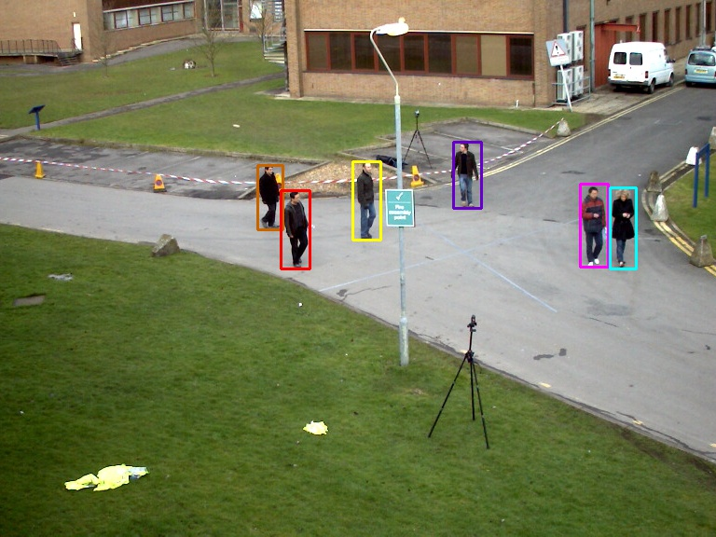
Detector Improvement
The paper used HOG for feature extraction and SVM for decision
A COCO dataset pretrained deep learning based model from tensorflow called faster_rcnn_nas_lowproposals_coco is selected
Out-of-the-box detection result comparison
faster_rcnn_nas_lowproposals

Slide 16
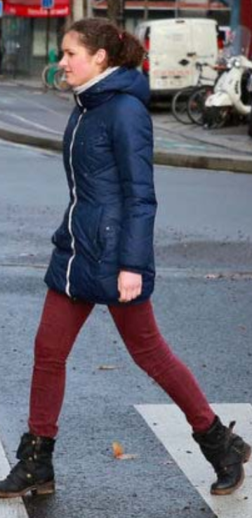
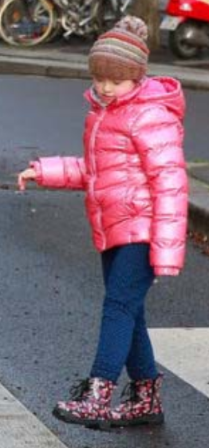
Appearance Model
The paper trained a boosted binary classifier online for each object.
Two part HSV histogram model inspired by Okuma’s paper is used in this project.
Compare HSV histogram
Compare HSV histogram
Okuma’s paper: A Boosted Particle Filter: Multitarget Detection and Tracking, ICCV 2005
Notes:
, the goal of the classifier is to classifier whether a bounding box image has the same identity as this class or not.

Slide 17
Likelihood weight calculation

Slide 18
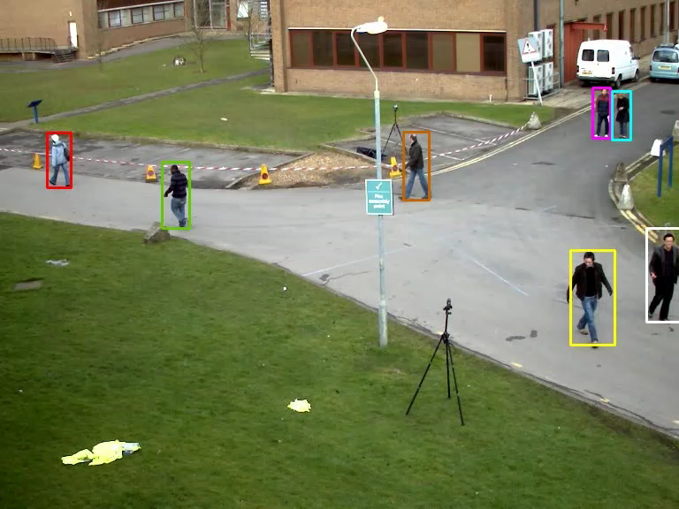
Tracking demo
PETS 2009 dataset S2 L1 clip

Slide 19
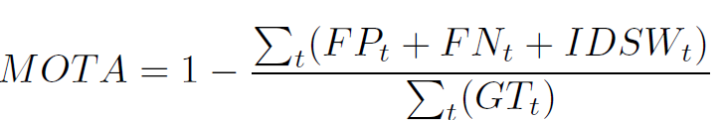
Evaluation Method
Notes:
Most widely used scoring matrix, it does not exist when the paper was published

Slide 20
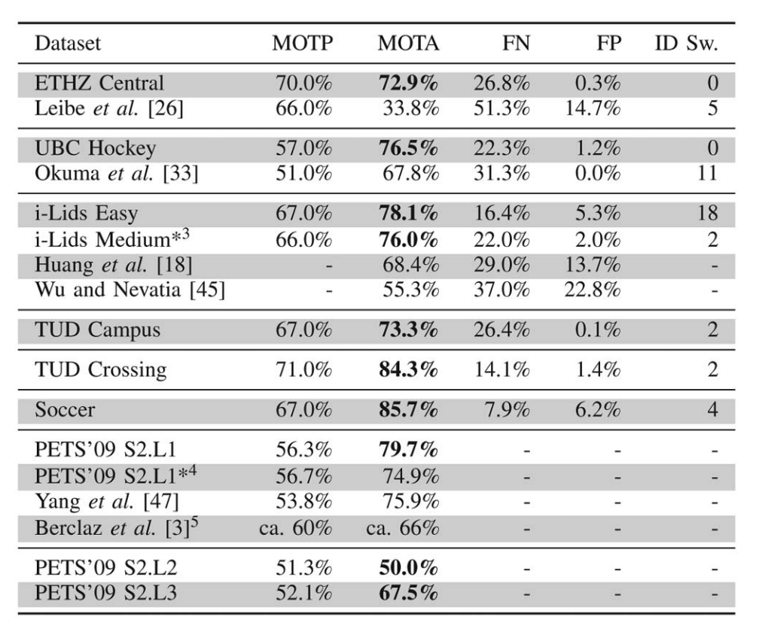
Result comparison
Tracking result from a later paper by the same authors using the same tracking model
Tracking result of this project
CLIP | MOTA | Precision | FN | FP | IDSW
PETS 2009 S2L1 | 82.4% | 93.7% | 11.57% | 5.89% | 36
The table on the right is taken from Online Multiperson Tracking-by-Detection from a Single, Uncalibrated Camera by Breitenstein et. al.

Slide 21
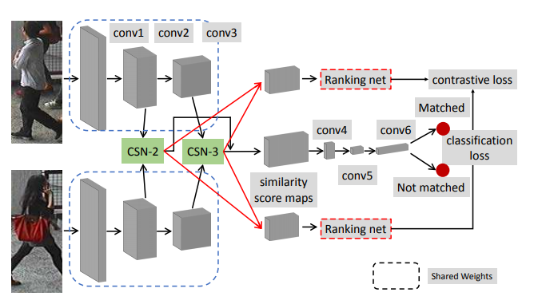
Potential Improvement
Use a deep learning based detector dedicated to pedestrian detection
Use a better motion model instead of assuming constant speed
Use a deep learning based Re-ID model as the appearance model For example: Efficient and Deep Person Re-identification Using Multi-level Similarity by Guo and Cheung, CVPR 2018
Architecture:
Image taken from Efficient and Deep Person Re-identification Using Multi-level Similarity by Guo and Cheung

Slide 22
So how do we use the particles to track an object?
maximum a posteriori (MAP)!
Maximize the posterior, which is maximize the probability of currently state happening given an observation, in our case bounding boxes HSV histogram, etc.

